Slide 1
Net Family Assets

Slide 2
MFH HOTMA Video Series for Owners

Slide 3
Agenda

Slide 4
Today’s Training Objectives

Slide 5
HOTMA Background

Slide 7
HOTMA Compliance Dates

Slide 8
Key Changes in “Net Family Assets”

Slide 9
Key Changes in “Net Family Assets”

Slide 10
HOTMA’s Asset Limitation

Slide 11
What Is an Asset?

Slide 12
Net Family Assets: Relevancy

Slide 13
Net Family Assets: Relevancy

Slide 14
Step 1: Collect Family Asset Information

Slide 15
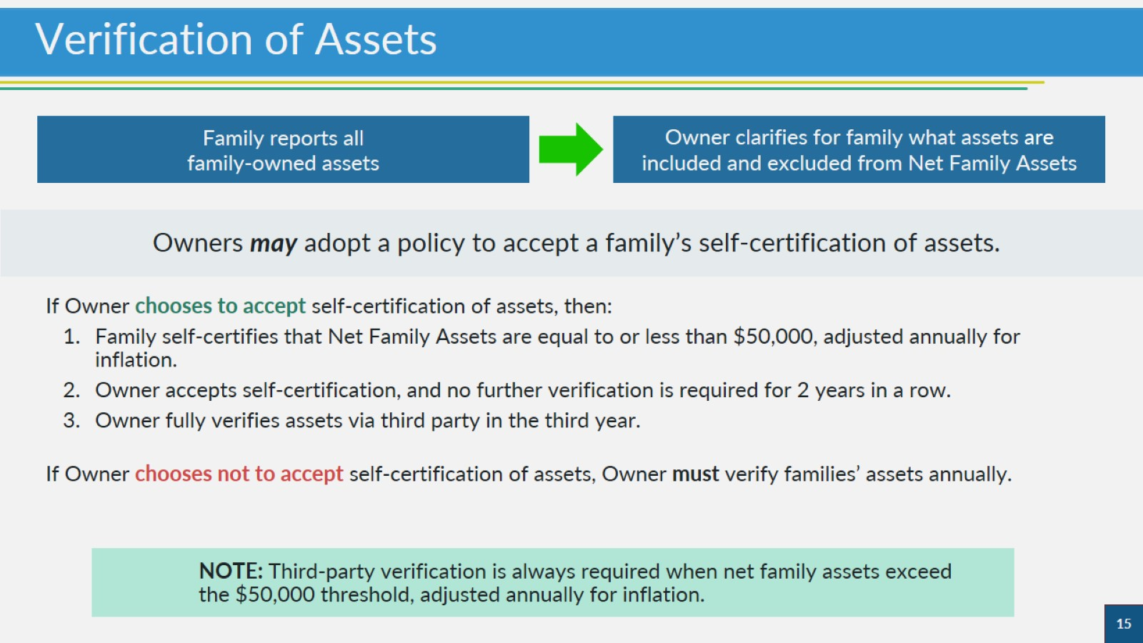
Verification of Assets

Slide 16
Family Self-Certification of Assets

Slide 17
Step 2: Determine If Asset is Included in Net Family Assets

Slide 18
New Definition of Net Family Asset

Slide 19
Net Family Assets: Necessary Personal Property

Slide 20
Net Family Assets: Necessary Personal Property

Slide 21
Net Family Assets: Non-Necessary Personal Property

Slide 22
Net Family Assets: Non-Necessary Personal Property

Slide 23
Net Family Assets: Exclusions

Slide 24
Knowledge Check

Slide 25
Knowledge Check

Slide 26
Trusts as Net Family Assets

Slide 27
Trust Distributions and Net Family Assets

Slide 28
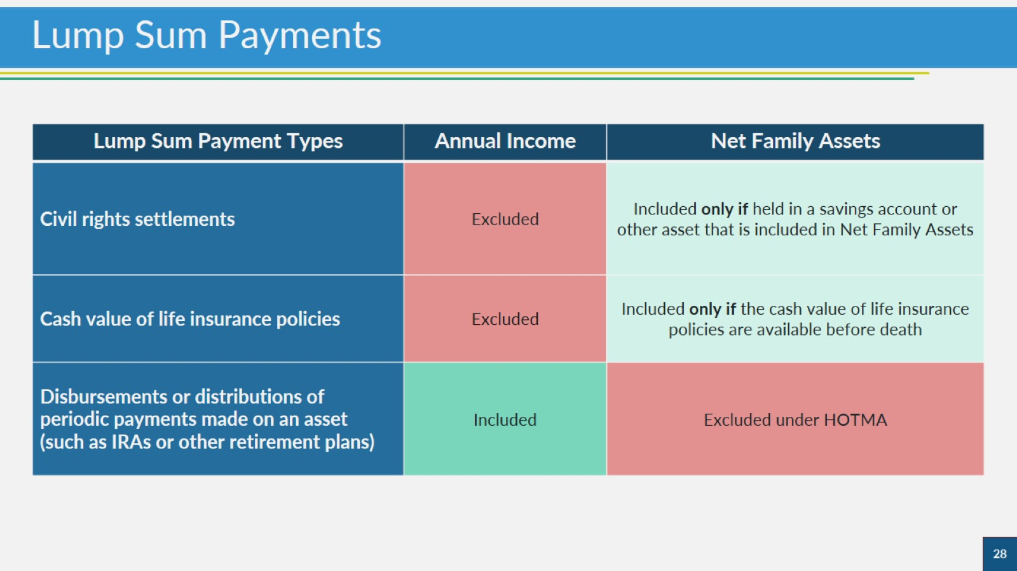
Lump Sum Payments

Slide 29
Federal Tax Refunds or Refundable Tax Credits

Slide 30
Assets Disposed of for Less Than Market Value

Slide 31
Negative Equity

Slide 32
Summary: Determining Net Family Assets

Slide 33
Example List of Net Family Assets

Slide 34
Example List of Net Family Assets

Slide 35
Example List of Net Family Assets

Slide 36
Knowledge Check

Slide 37
Knowledge Check

Slide 38
Step 3: Tallying the Value of Net Family Assets

Slide 39
Calculating Net Cash Value

Slide 40
Calculating Net Cash Value

Slide 41
Tallying Net Cash Value

Slide 42
Knowledge Check

Slide 43
Knowledge Check

Slide 44
Step 4: Calculate Income from Net Family Assets

Slide 45
Asset Income to Be Counted

Slide 46
Actual Income From Assets

Slide 47
Imputed Income

Slide 48
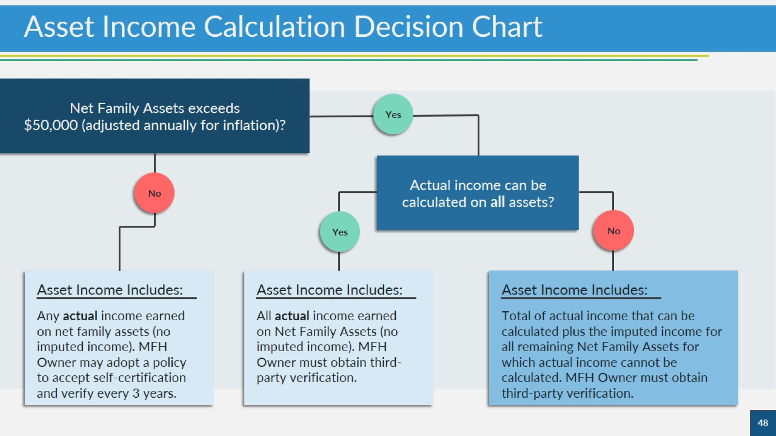
Asset Income Calculation Decision Chart

Slide 49
Passbook Rate

Slide 50
Inflationary Adjustment

Slide 51
Asset Income Calculation Scenarios

Slide 52
Asset Income Calculation Scenarios

Slide 53
When Net Family Assets Do Not Exceed Threshold

Slide 55
When Net Family Assets Exceed Threshold

Slide 56
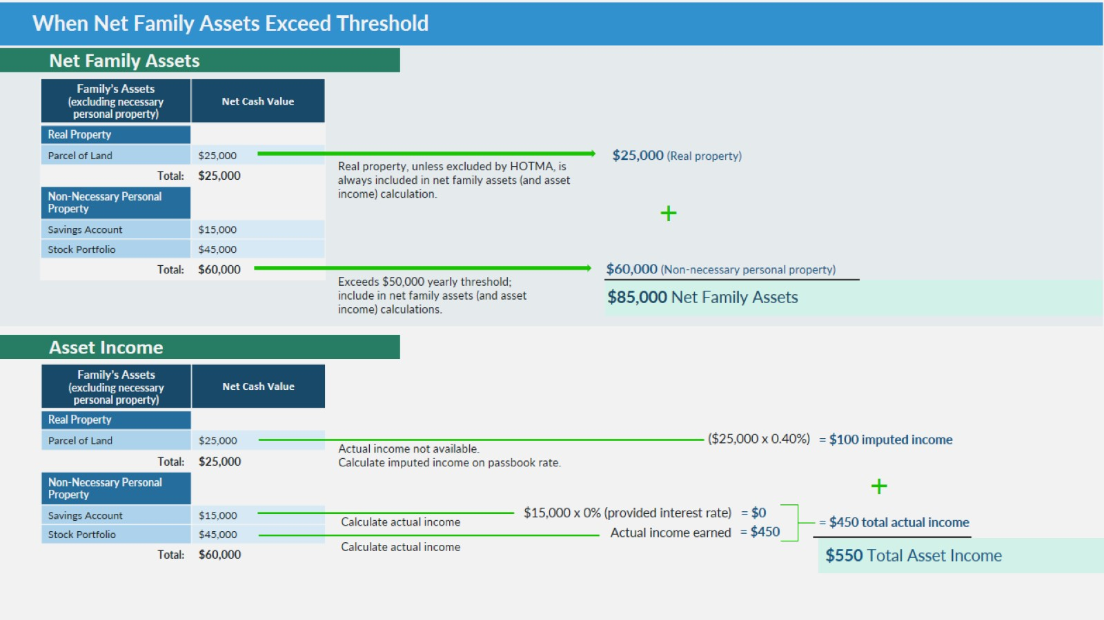
When Net Family Assets Exceed Threshold

Slide 57
Knowledge Check

Slide 58
Knowledge Check

Slide 59
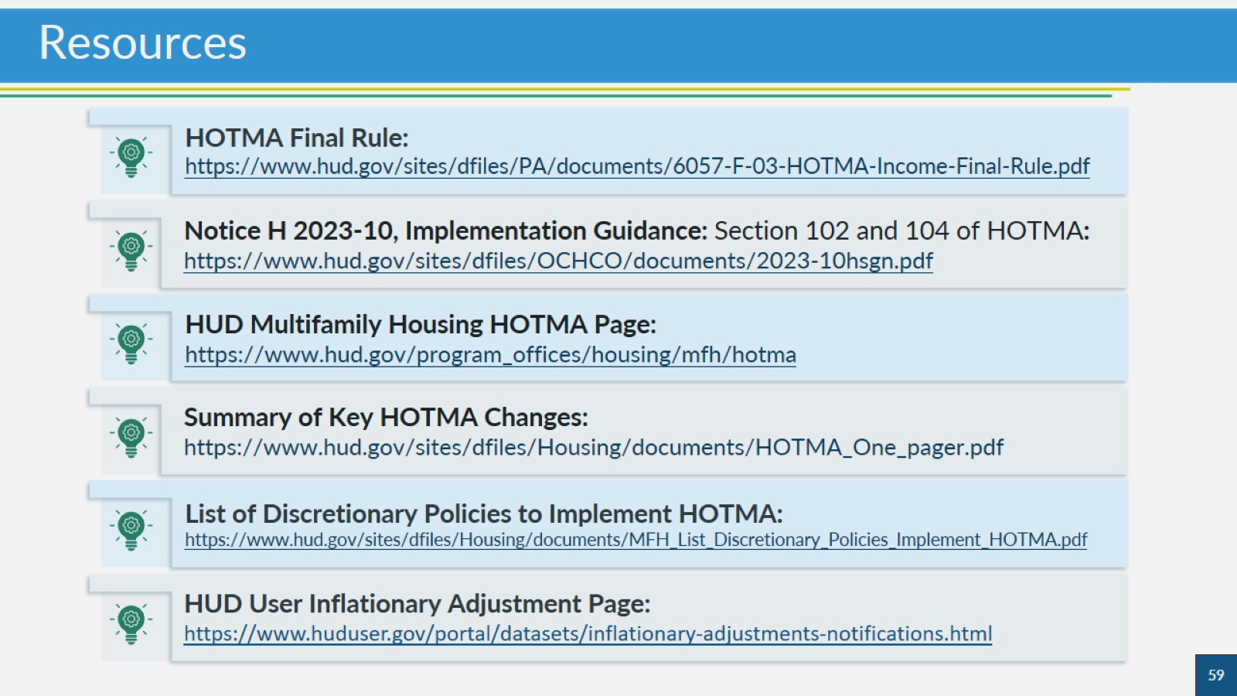
Resources

Slide 60
Thank you!

